Slide 1
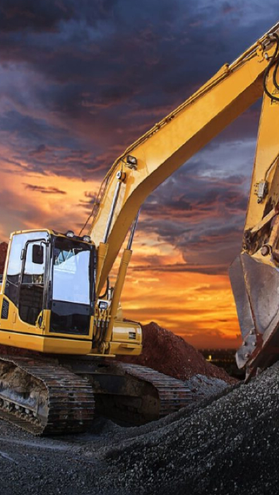

Machine Rental System
Rangga aulia,
Herjuno Ridho,
Alpay Demirci,
Juan Alejandro Sola Castermans,
Jarno Dijkmans

Slide 2
01
TABLE OF CONTENTS
What have we done?
02
Demo
03
Did we resolve the problem?
04
Reflection
05
Looking forward in time
06
End

Slide 3
01
What have we done?
Functionalities
Discount
Email confirmation
Modifications in pricing

Slide 4
02
Demo

Slide 5
Did we resolve the problem?
03
Booking making/managing is now online instead of with paper.
Clear and attractive website for the users.
Safe Application.
Application designed for extension due to its structure.

Slide 6


04
Reflection
Positives
Improvements
Motivated
Helping hand
Effort
Communication
Working in a team
Responsibility
Use of git-branches

Slide 7
Looking forward in time
05
More advanced discount system.
Administration page.
Employee platform.
Add accessories logic.

Slide 8
06
Thank you for your attention!
Are there any questions?

